Slide 1



Slide 2



Slide 3

DATA STRUCTURE OF THE APPLICATION
Number
String
Price
Image
Descript
Currency

Slide 4

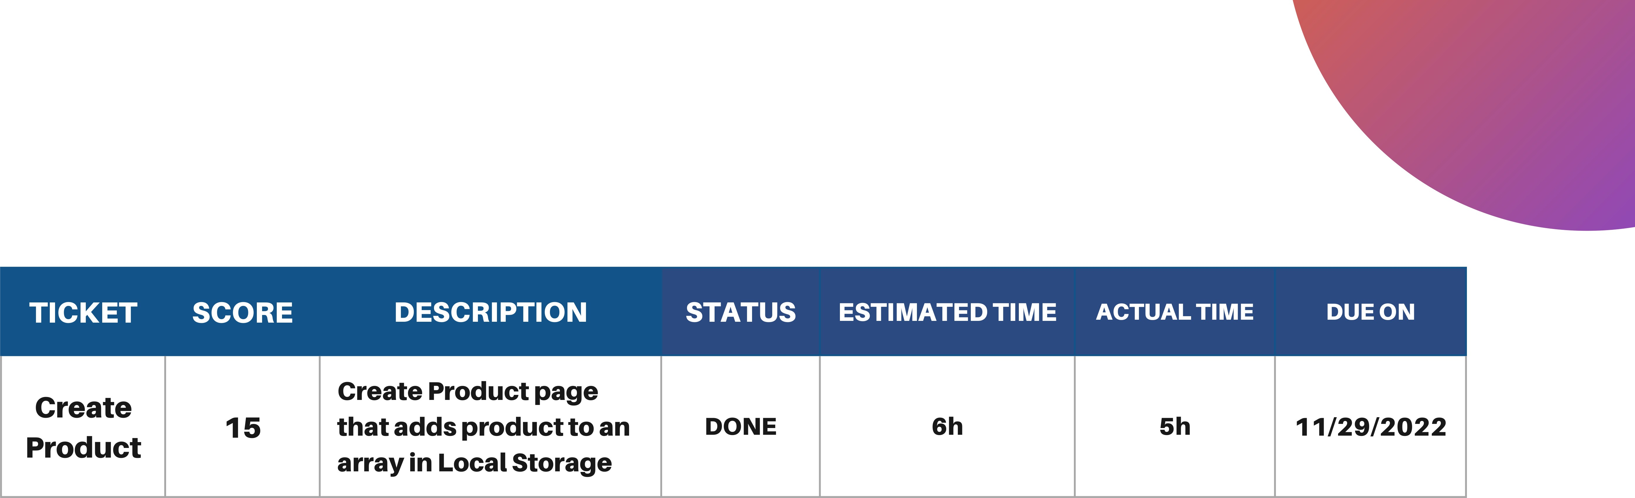
Task | Create product | Estimated | Actual Time
Subtask -1 | Get value form input | 2 h | 3h
Subtask -2 | Store value in local Storage | 1 h | 1h

Slide 5

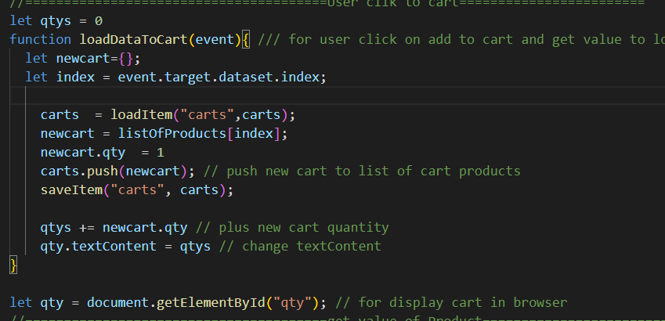
EXPLAIN CODE

Slide 6

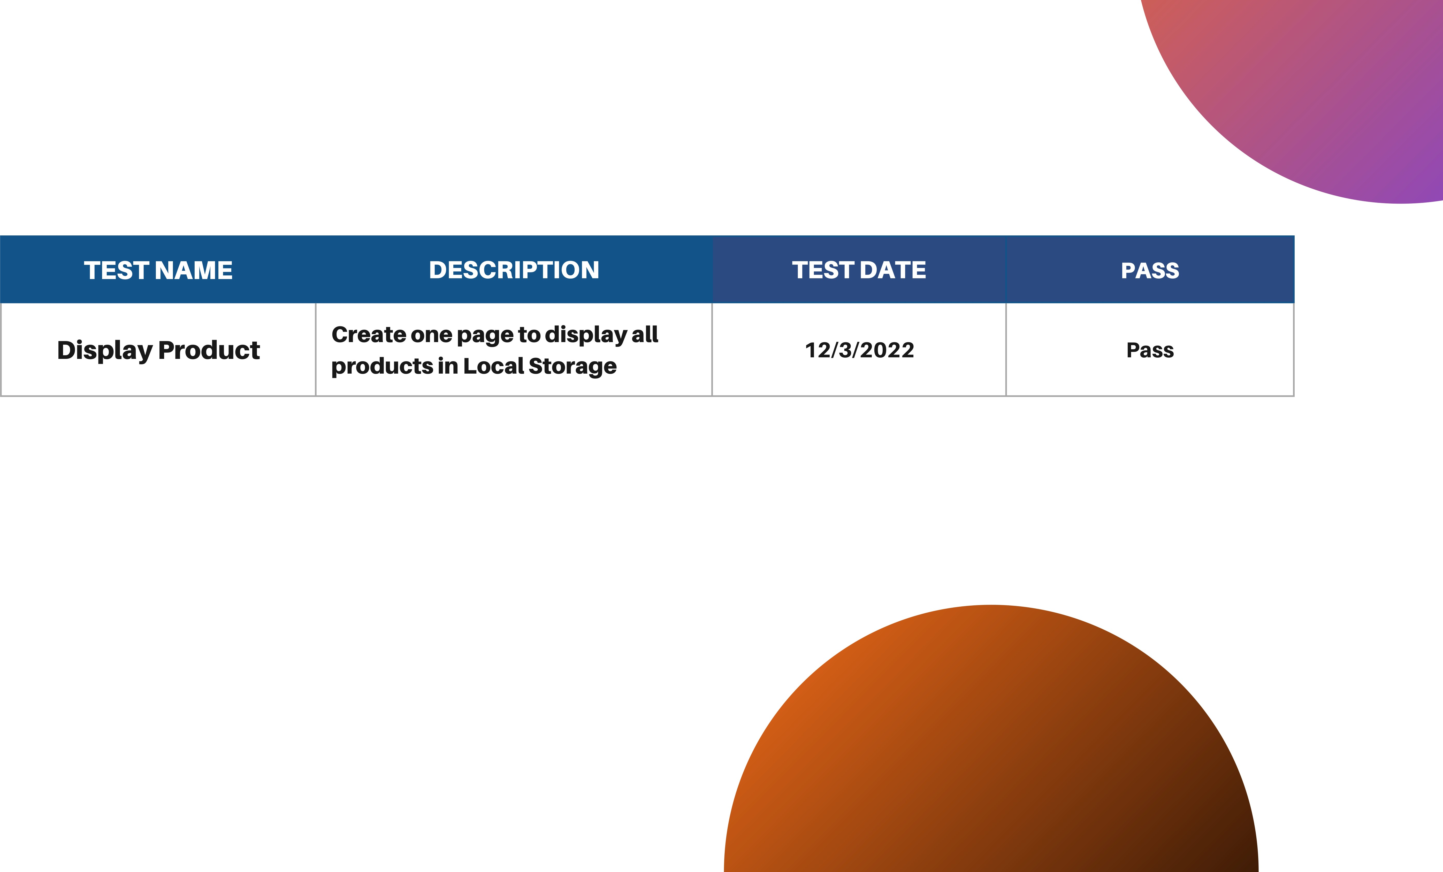

TEST PAGE

Slide 7


